Slide 1
Recent Research Work in TULIP Lab
Gang Li
School of Information Technology
Deakin University, Australia

Slide 2
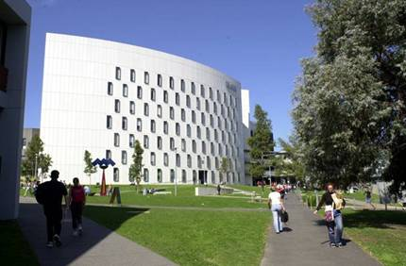
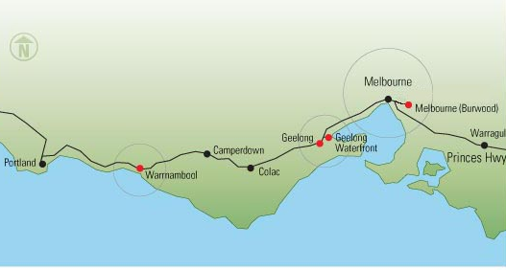



Deakin University, Australia

Slide 3
Our rankings
 | Benchmark | 2012-13 | 2013-14 | 2014-15
QS# | World National Victoria Under 50 | 425 23 5 | 380 19 4 | 360 19 4 50
THE | World National Victoria | 375 15 3 | 375 15 3 | 325 13 3
THE<50 | World National Victoria | 78 8 1 | 66 7 1 | 59 7 1
ARWU | World | Not Ranked | Not Ranked | 401-500 19 4
CWTS Leiden | World National Victoria | Not Ranked | Not Ranked | 284 11 3
# Deakin obtained a QS 5 star ranking in 2011 – applicable for three years.
# Deakin C.S. is ranked top 1% globally

Slide 4

TULIP Lab (Team for Universal Learning and Intelligent Processing)
A/Prof. Gang Li
IEEE Technical Committee
Data Mining and Big Data Analytics (Vice Chair 2017)
Enterprise Information Systems
Enterprise Architecture and Engineering
Vice chair IEEE Task Force on EDM
Deakin
University Thesis Examination Committee
SEBE Faculty HDR Director
Current Director for
S578/S678/S778/S779 (Master of Information Technology)
Founding Director for
S306 (Bachelor of Computer Science)
S777 (Master of Data Analytics)

Slide 5
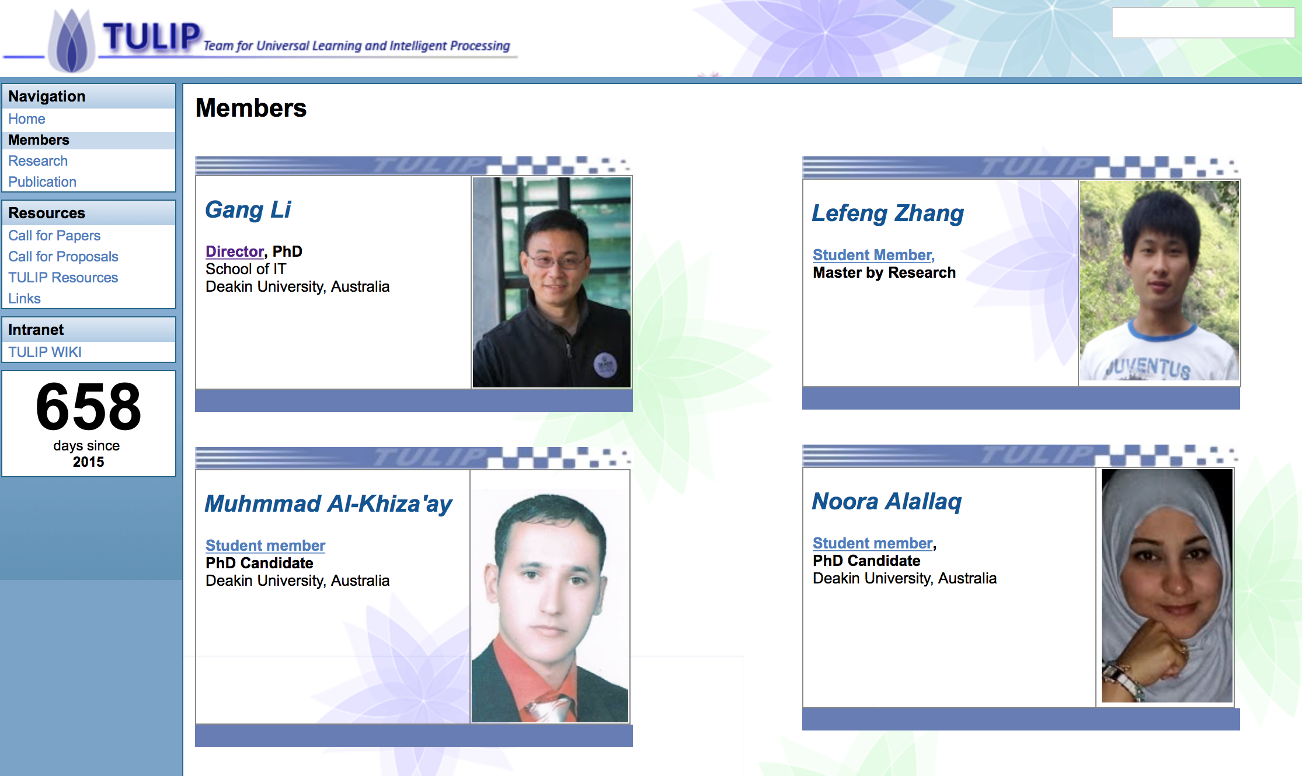
TULIP Lab (Team for Universal Learning and Intelligent Processing)

Slide 6
TULIP Lab (Team for Universal Learning and Intelligent Processing)
Current Research Topics@ TULIP Lab
Behaviour Informatics
Bioinformatics
Health/Medical Informatics
Intelligent Services
Data Compliance Checking
Privacy Preservation in Data Mining
Business Intelligence
Recommender System
Tourism/Hospitality Management

Slide 7
P.R. Applications (Case 1: Face Age Recognition)
Xin Geng, Zhi-Hua Zhou, Yu Zhang, Gang Li, Honghua Dai. Learning from facial aging patterns for automatic age estimation. Proceedings of the 14th annual ACM international conference on Multimedia, 2006

Slide 8
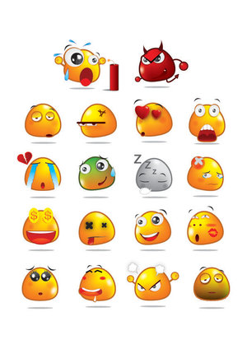

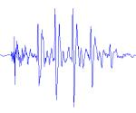
P.R. Applications (Case 2: Speech-based Emotion Detection)
Jia Rong, Gang Li, Yi-Ping Phoebe Chen: Acoustic Feature Selection for Automatic Emotion Recognition from Speech. Information Processing and Management, 45(3): 315-328 2009

Slide 9
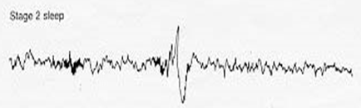
P.R. Applications (Case 3: K-Complex Detection)
Sleep Stage Identification
Rapid Eye Movement (REM) Sleep
A normal stage of sleep characterized by the rapid movement of the eyes (is relatively easily discernible in PSG)
20%-25% of total sleep time in human adults, memorable dream
Non-REM Sleep
N1: slow eye movement, hypnic jerks at beginning, believe fully awake
N2: non eye movement, rare dreaming, easily awaken
N3: deep sleep, sometimes dreaming, but disconnected, less vivid
General sleep order in cycles of REM and NREM: N1 → N2 → N3 → N2 → REM
Early in the night, a greater amount of deep sleep (N3)
Later in the night, REM sleep increases, and before natural awakening
Vu, Quan; Li, Gang; Sukhorukova, Nadezda; Beliakov, Gleb; Liu, Shaowu; et al. K-complex Detection using a Hybrid-Synergic Machine Learning method. IEEE Transactions on SMC(C), PP(99): 1-13.

Slide 10
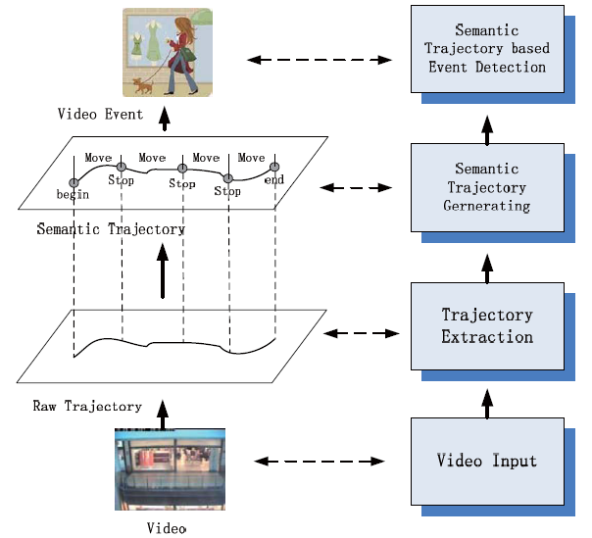
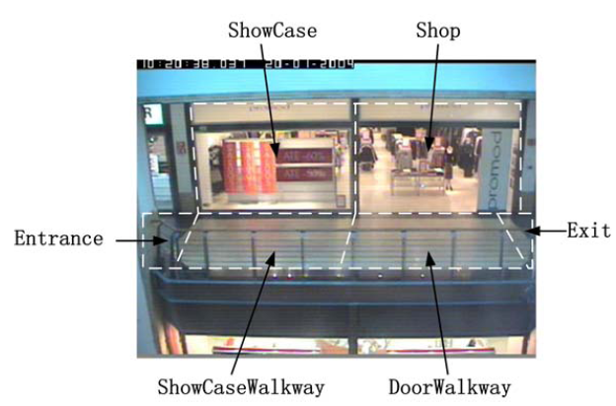
P.R. Applications (Case 4: Trajectory Analysis)
Xiaofeng Wang, Gang Li, Guang Jiang, Zhongzhi Shi. Semantic Trajectory based Event Detection and Event Pattern Mining, Knowledge and Information Systems (KAIS), pp. 1-25, 2011.

Slide 11
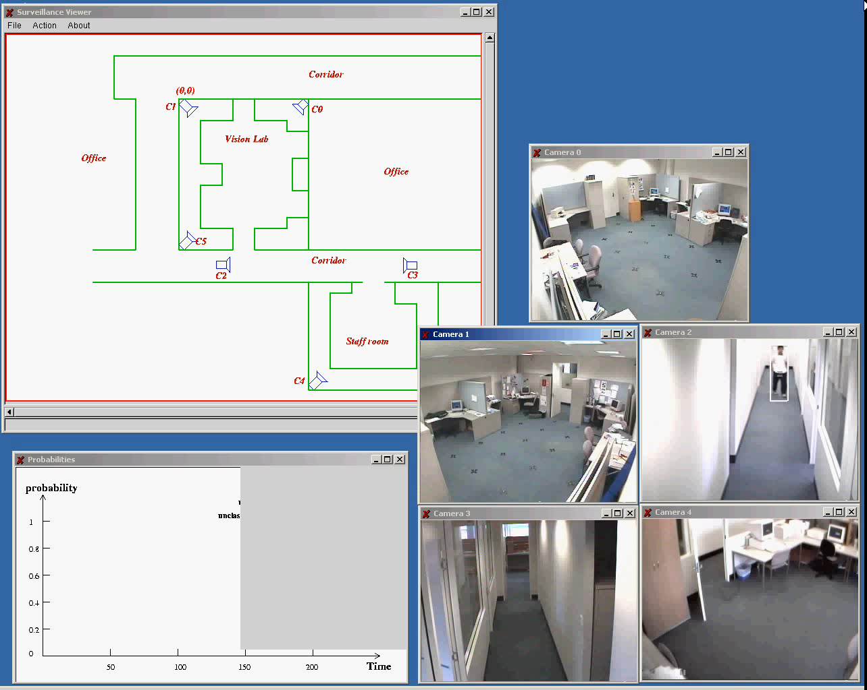
P.R. Applications (Case 5: Video Surveillance)

Slide 12
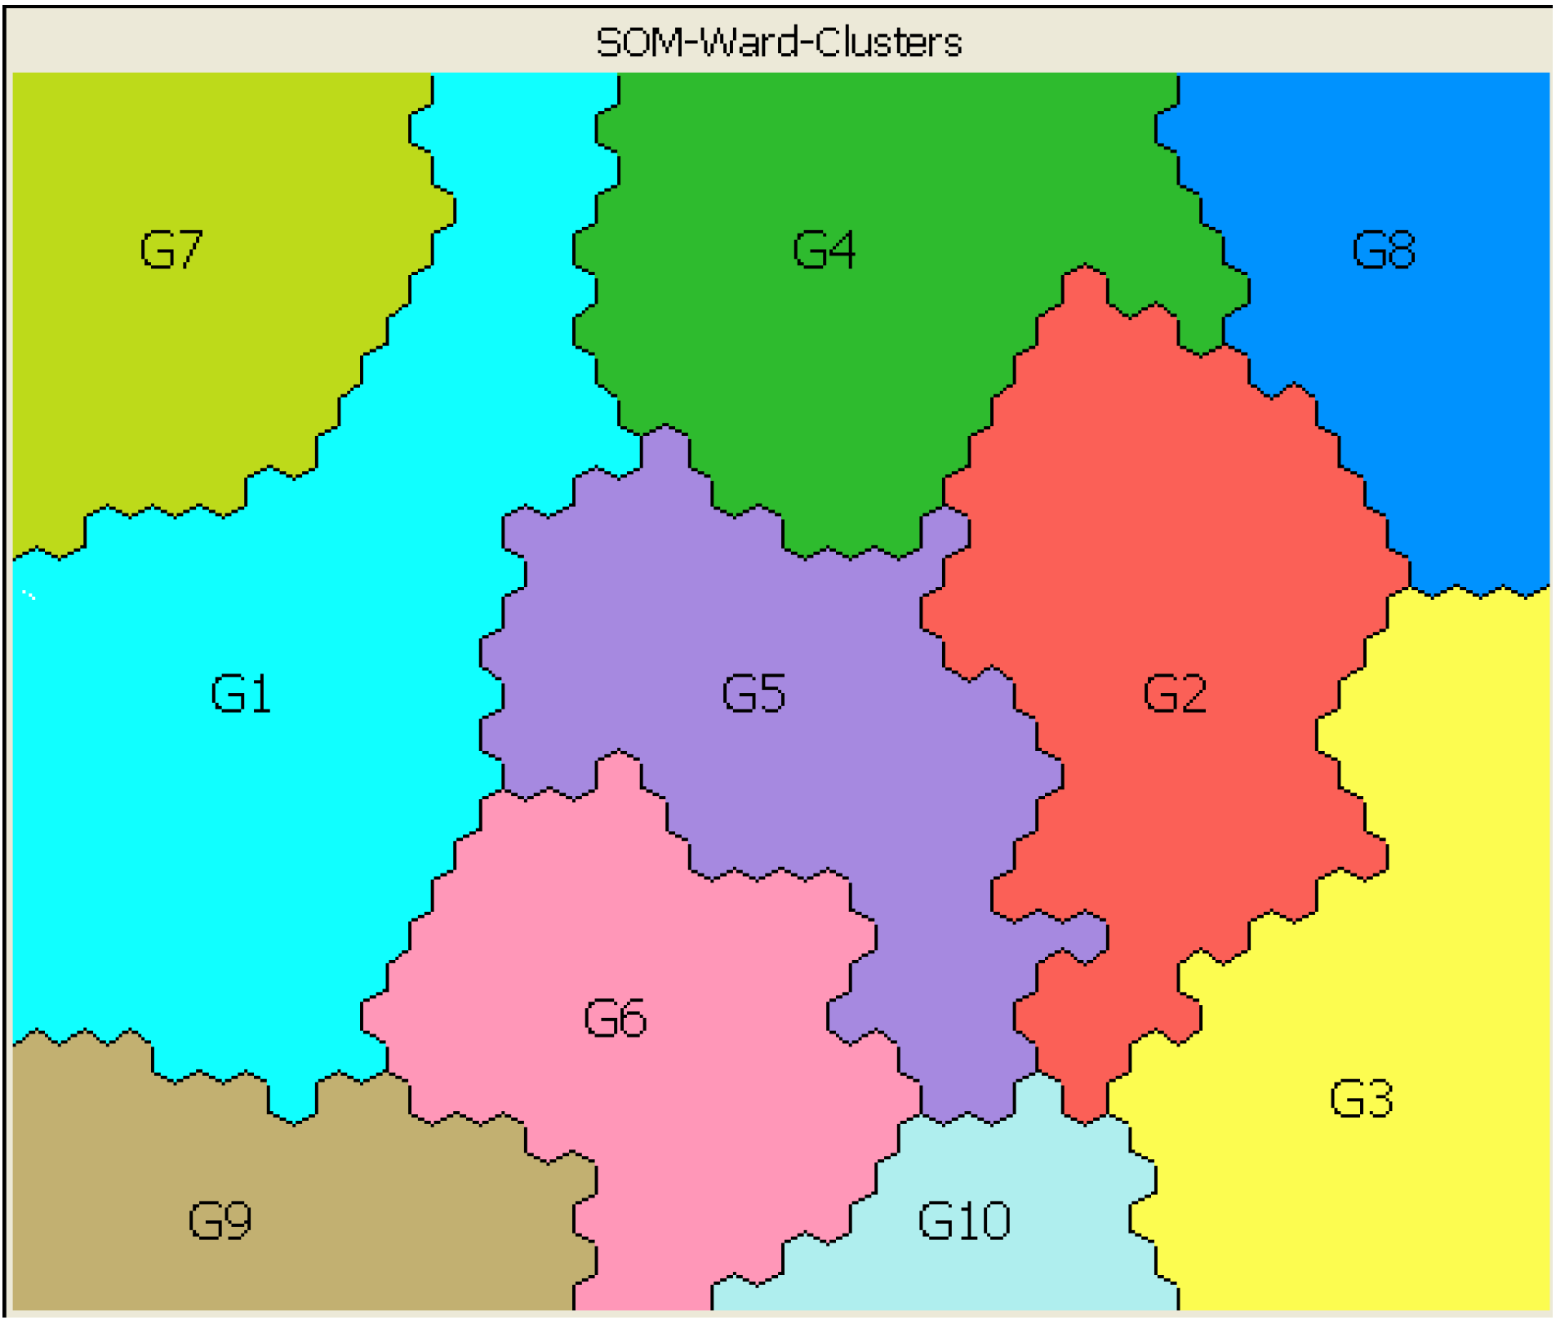
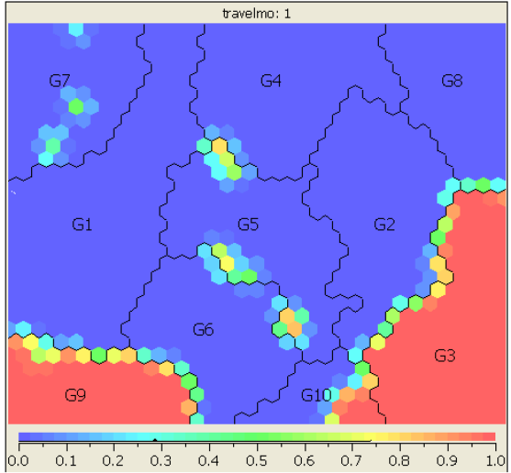
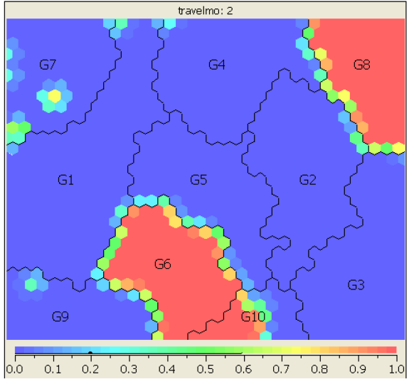
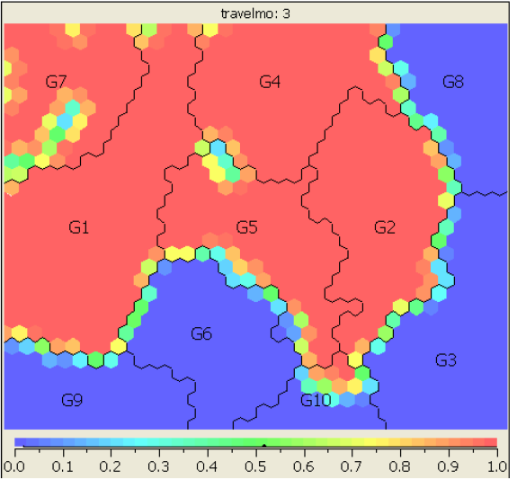
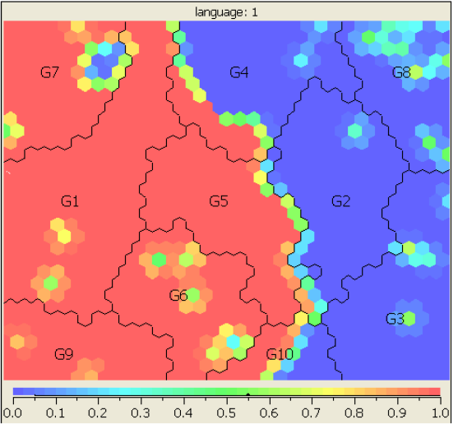
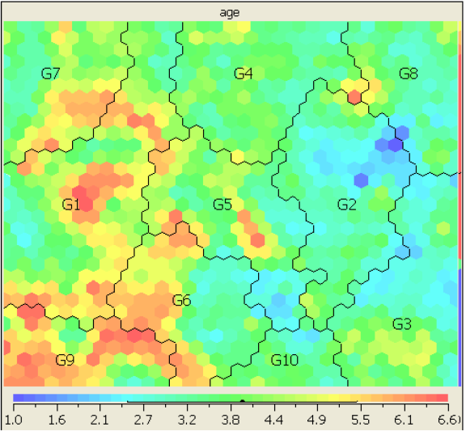
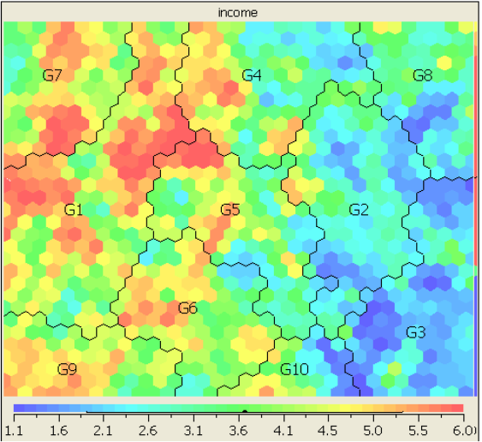
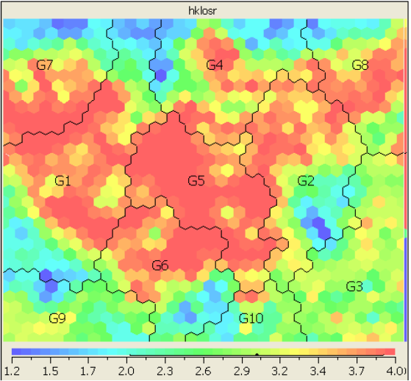
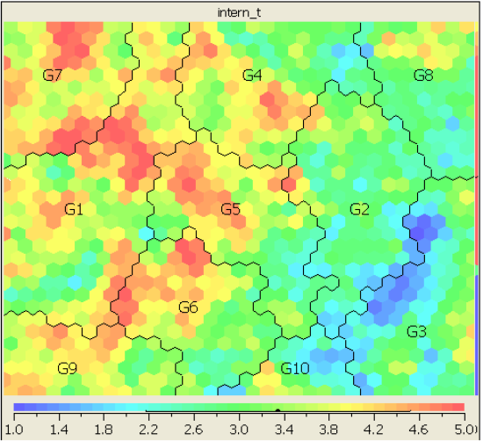
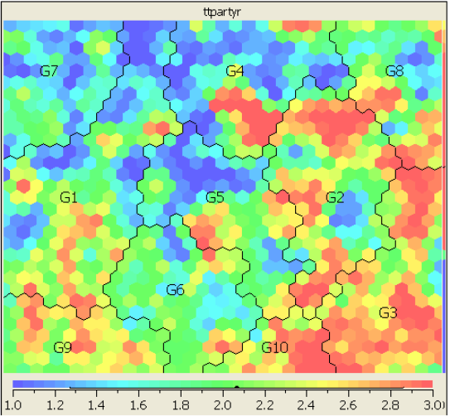
Market Segmentation Analysis
Travel Mode: 1
Travel Mode: 2
Travel Mode: 3
Language: 1
Age
partially packaged
Income
HK Length of Stay
Travel Experience
High income
Travel Party
Low income
partially packaged
old
Fully packaged
Fully packaged
Notes:
Asian Tourists are likely to flow to Hong Kong central area from surrounding areas Tourist from Center Mong Kok tend to visit Tsim Sha Tsui as the next destination while, somes chose to travel directly to Hong Kong Central. Considerable tourist flow are found from Hong Kong Central and Times Square Towers to Tsim Sha Tsui
Western tourists tend to visit Hong Kong Central directly right after visiting Center Mong, while, somes travel in the opposite direction. Tourists are more likely to visit Tsim Sha Tsui than Hong Kong Central after visiting Times Square Towers. Some tourists visited Tsim Sha Tsui right after going to the Peak Tower.

Slide 13
Negative Association Rule Mining
Transaction
Data
Sup(AUB) ≥ min_sup
Candidate Interesting Positive
Item-set
lever(AUB) ≥ min_lever
Generating Targeted
Item-set
Interesting Positive Item-set
User specified
Target Item
confi(A→~B) ≥ min_confi
Sup(AUB) < min_sup
Positive
Rules
Candidate Interesting Negative
Item-set
lever(AU~B) ≥ min_lever
confi(A→~B) ≥ min_confi
Interesting Negative Item-set
Negative
Rules
Reporting
Rules

Slide 14
Contrast Mining
Contrast Targeted Rules Algorithm (CTR):
Detect the changes of rules strength between differences year data set.
Tracing the trend for predicting future potential.
2008
2010
V.S
?
A→B
A→B
?
A→B
A→B
2008
2009
2010
2011
…

Slide 15
Contrast Mining
Based on a segmented data, identify the features that can distinguish it from others
How to make attractive advertisement
How to know your own strength, and everyone else’s strength.

Slide 16

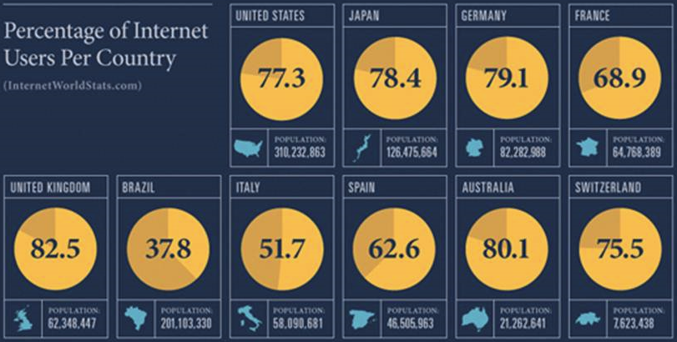
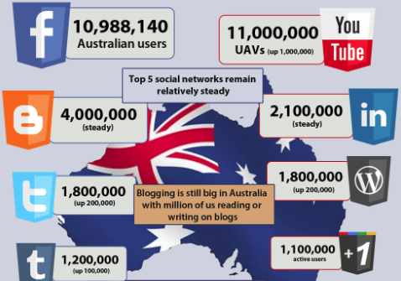
The Popularity of Online Social Networks
The popularity of OSNs has greatly increased in recent years
A large amount of Internet users also use OSN services,
Australia has up to 11 million Facebook users.

Slide 17


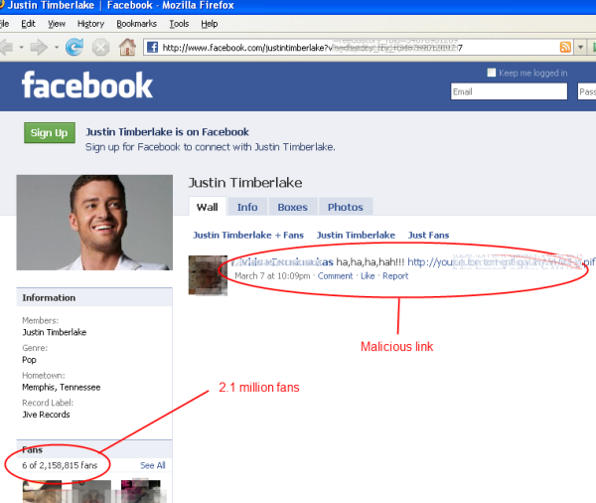


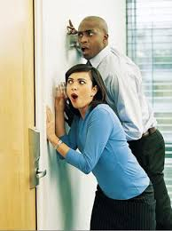

The Popularity of Online Social Networks
People share news, interests and ideas in OSNs,
though these platforms also spread email malware, rumours, gossips and malicious links, and also leak our privacy.

Slide 18
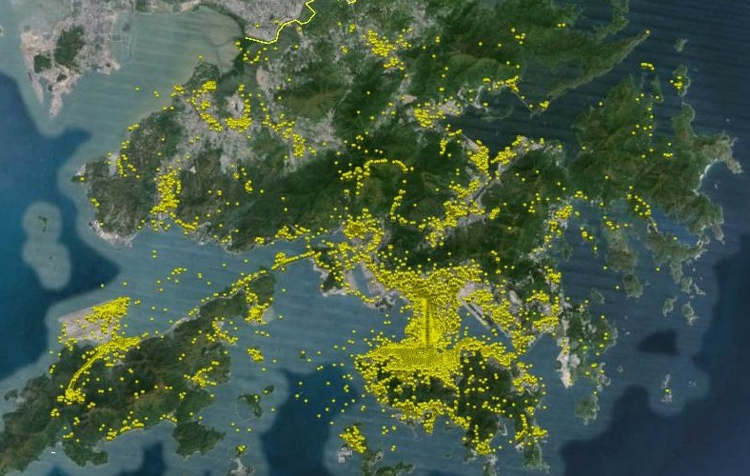

Application of Geo Photos
There are many geotagged photos available. However :
Data is noisy or misleading.
Photos are taken in transit rather than at the attractions.
Photo is static media, whereas, travel behavior is dynamic.
How to mine these data for travel behaviour analysis?

Slide 19
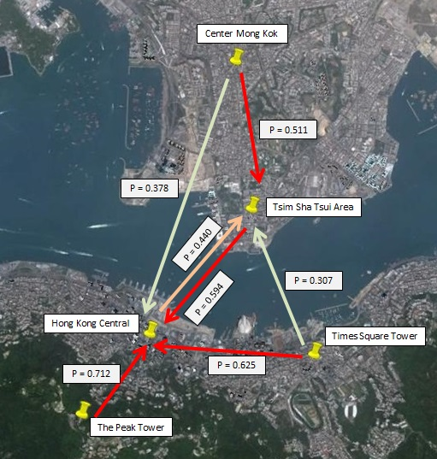
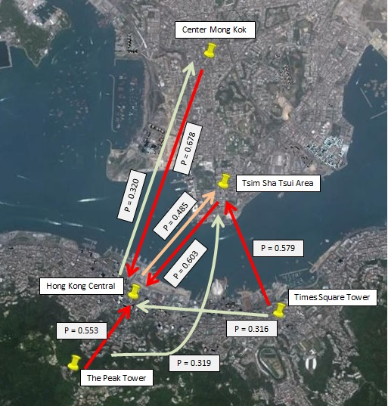
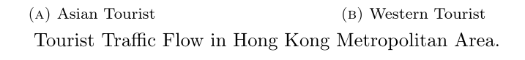
Tourist Movement Analysis
Notes:
Asian Tourists are likely to flow to Hong Kong central area from surrounding areas Tourist from Center Mong Kok tend to visit Tsim Sha Tsui as the next destination while, somes chose to travel directly to Hong Kong Central. Considerable tourist flow are found from Hong Kong Central and Times Square Towers to Tsim Sha Tsui
Western tourists tend to visit Hong Kong Central directly right after visiting Center Mong, while, somes travel in the opposite direction. Tourists are more likely to visit Tsim Sha Tsui than Hong Kong Central after visiting Times Square Towers. Some tourists visited Tsim Sha Tsui right after going to the Peak Tower.

Slide 20
Tourist Movement Analysis
Huy Quan Vu, Gang Li, Rob Law, Ben Haobin Yip. Exploring the travel behaviors of inbound tourists to Hong Kong using Geotagged photos. Tourism Management.

Slide 21

Concerns on Data Privacy
Privacy Breach by Released Photos
Privacy Breach by Released Datasets

Slide 22
Is O.S.N. a Secure Place to Show off?

Slide 23
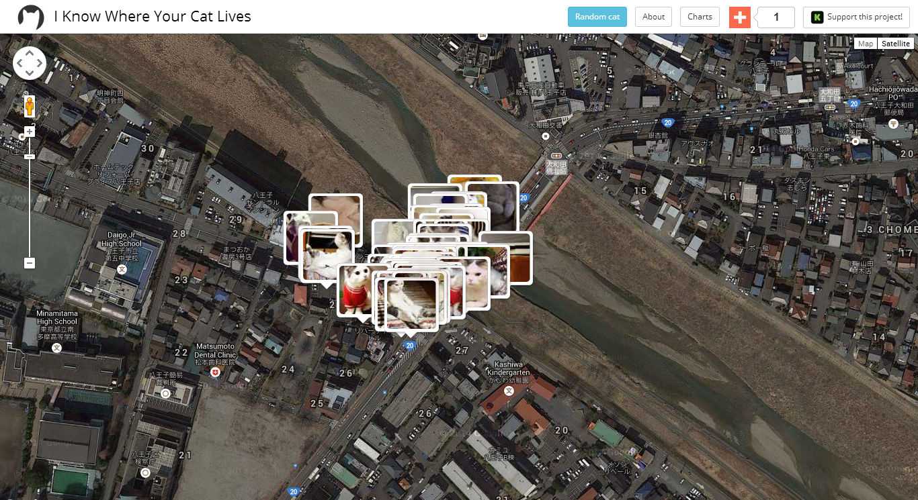
I Know Where Your Cat Lives
This project randomly selected one million images that include the word “cat” across public photo sites, which plots the location coordinates from each photo against a map to show where each cat lives. ---- July 22, 2014 Time
http://time.com/3019671/i-know-where-your-cat-lives-website-data-visualization/
Notes:
Mashable points out that a new data visualization project called “I Know Where Your Cat Lives” is trolling the internet and collecting metadata in your #adorable #cat #picture. Using the geotags embedded in the metadata in public photos, the project collects the information and puts the cat’s location on a map perfect for cyberstalking your fuzzy feline friend.
http://time.com/3019671/i-know-where-your-cat-lives-website-data-visualization/
The site features cats from everywhere around the globe — a giant red tom in Chiba, Japan to a grey fuzzball kitten in Apulia, Italy to a kitten cuddled with his mom in Queensland, Australia — all available for gawking at and cooing over at the click of a button.

Slide 24
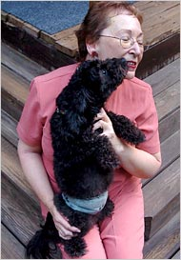
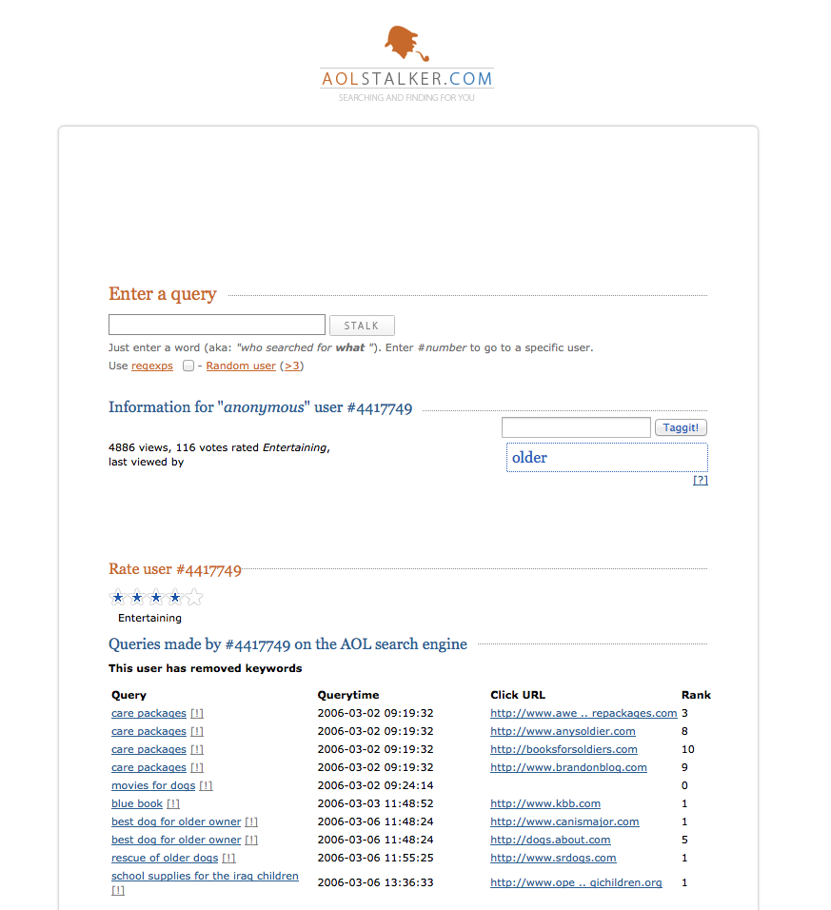
AOL Dataset Debacle
AOL search data leak (2006):
36 million search terms of 650,000 users
http://search-id.com
http://www.aolstalker.com
I Know who you are
Click history can uniquely identify a person
Find all log entries for AOL user 4417749
Multiple queries for businesses and services in Lilburn, GA (population 11K)
queries for Jarrett Arnold
Lilburn has 14 people with the last name Arnold
NYT contacts them, finds out User 4417749 is Thelma Arnold

Slide 25
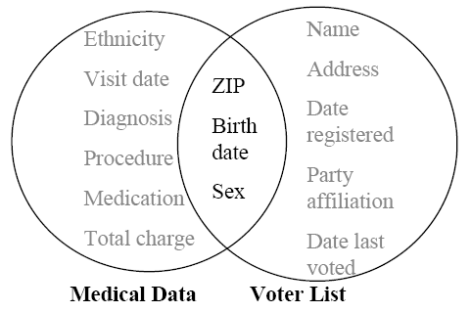
Breach of medical record
87% of Americans can be uniquely identified by
{zip code, gender, date of birth}
Latanya Sweeney re-identify the medical record of an ex-governor of Massachusetts.
[International Journal on Uncertainty, Fuzziness and Knowledge-based Systems, 2002]

Slide 26
Breach of medical record
Linkage Attacks
Using “innocuous” data in one dataset to identify a record in a different dataset containing both innocuous and sensitive data
At the heart of the voluminous research on hiding small cell counts in tabular data

Slide 27


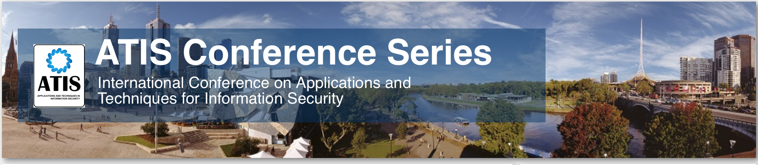
Related Conferences

Slide 28
Collaboration with Deakin
Industry Engagement Scheme
PhD Scholarship
Postdoc Fellowship

Slide 29
ARC Linkage Project
Australian Research Council
Industry partner
Long Term collaboration
Priority Research Areas
With track records

Slide 30
SEBE Industry Engagement Scheme
The SEBE Industry Engagement Scheme is suitable for projects of high strategic alignment.
In the first instance preference will be given for those applications where at least 50:50 matched funding from the industry partner is committed.
SEBE contributes $5K-30K for each project

Slide 31
SEBE Industry PhD Scholarships
An industry funded scholarship should include stipend (currently $26,682 per annum) plus project costs of at least $5,000 per annum
SEBE’s current benchmark target rate for a “fully funded” scholarship is $40,000 cash per year for three years from the industry partner.
SEBE can contribute half of the stipend, conditional on the availability

Slide 32
SEBE Industry Postdoctoral Research Fellowships
A minimum cash contribution of $57,500 per year is required from the industry partner.
This is based on salary at Level A6-8 (currently $103K to $110K annually; including 27.46% on-costs) plus project costs.
SEBE’s benchmark target rate for a “fully funded” scholarship is $115,000 cash per year for three years

Slide 33
Questions?

Slide 34
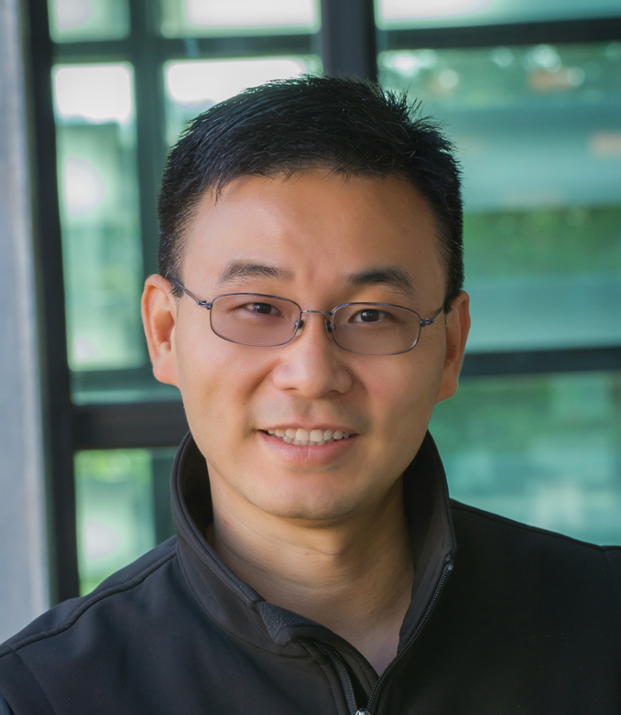
Contact
A/Prof. Gang Li
School of Information Technology, Deakin University VIC 3125, Australia
gang.li@deakin.edu.au
Phone: +61(3)925-17434
Office: T207.WS14 (Burwood)
Faculty HDR Coordinator
Director of TULIP Lab
http://www.tulip.org.au

